Slide 1
Design Presentation: Security
Owner: Sean Norman
CSA07P | 1 of 2
Session Day/Time: |  | Presenters/SMEs:
Virtual Format and Software:
Cohort / Breakout Mgmt
Objective of Session: | As a result of attending this, attendees will better be able to…
Existing Sources: | <link to any supporting content sources (if any)>
Learner Content: | <Link to draft ppt slide deck and any other materials that the attendees would be seeing or using as part of this session>
Presenter/ SME Guide Content: | <Link to any supporting materials that are just for the presenter and/or supporting SMEs>
Required Homework + name of session for HW review: | No homework or pre-required content needed for this session

Slide 2
Design Presentation: Security
Owner: Sean Norman
CSA07P | 2 of 2
Session Flow and Detailed Agenda |  | Presenter/SME: | Time
Prework | No attendee pre-work needed for this session | N/A | N/A
Session Introduction | Set context for when this process takes place | <presenter> | 3 mins
Body of the session / discussion, activities, Q&A... |  | <presenter> | 25 mins
Session Closing / Homework |  | <presenter> | 2 mins

Slide 3
Topics Covered
Synapse and Power BI Workspaces
Power BI in Synapse Studio
Performance optimization

Slide 4
Power BI in Azure Synapse

Slide 5

Agenda
1 Synapse and Power BI
Managing Power BI workspaces in Synapse Analytics
2 Power BI in Synapse
Working with Power BI features in Synapse Studio
3 Performance optimization
Improving Power BI performance with Synapse Analytics features

Slide 6
Synapse and Power BI

Slide 7
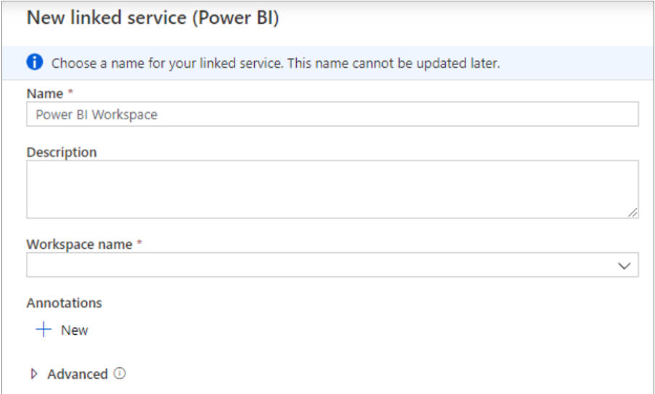
Connecting a Power BI Workspace in Synapse
Link the Power BI workspace in an Azure Synapse workspace
Manage > External connections > Linked services > New > Power BI

Slide 8
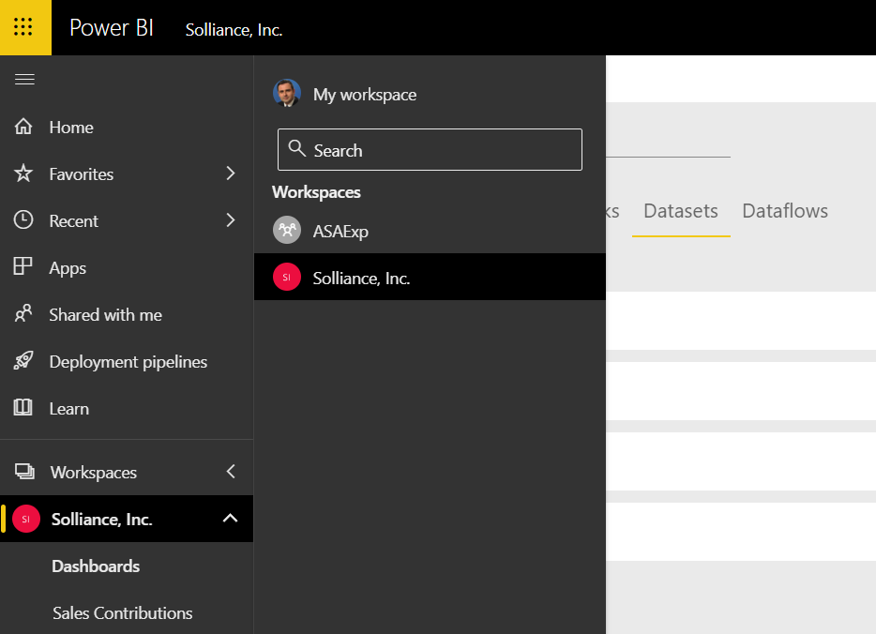
Connecting a Power BI Workspace - continued
Check the Synapse workspace in Power BI under Workspaces

Slide 9
Getting data from your Synapse workspace
Create a database (Databases are used only for viewing metadata, not for actual data.)
Configure credentials (You need to create credentials for storage account access)
Querying SQL on-demand
Select the Azure SQL Database as data source in the Power BI report
Enter the SQL on-demand endpoint of the Synapse workspace in the Server field
Querying SQL Pool
Select the Azure SQL Data Warehouse as data source in the Power BI report
Enter the SQL endpoint of the Synapse workspace in the Server field

Slide 10
Power BI in Synapse

Slide 11
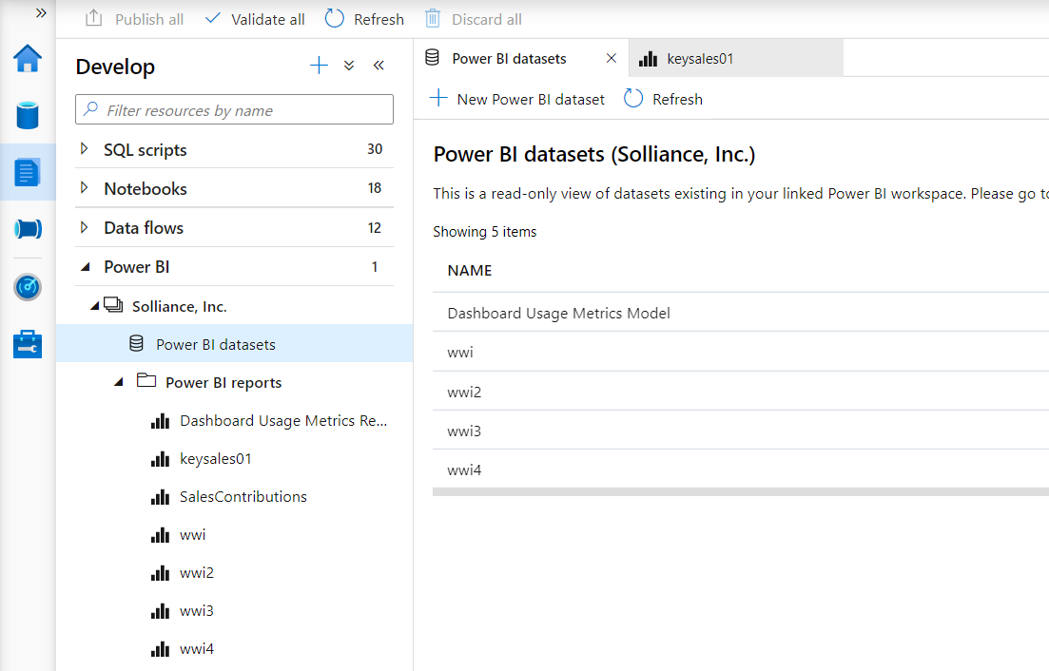
Work with Power BI in the Develop hub

Slide 12
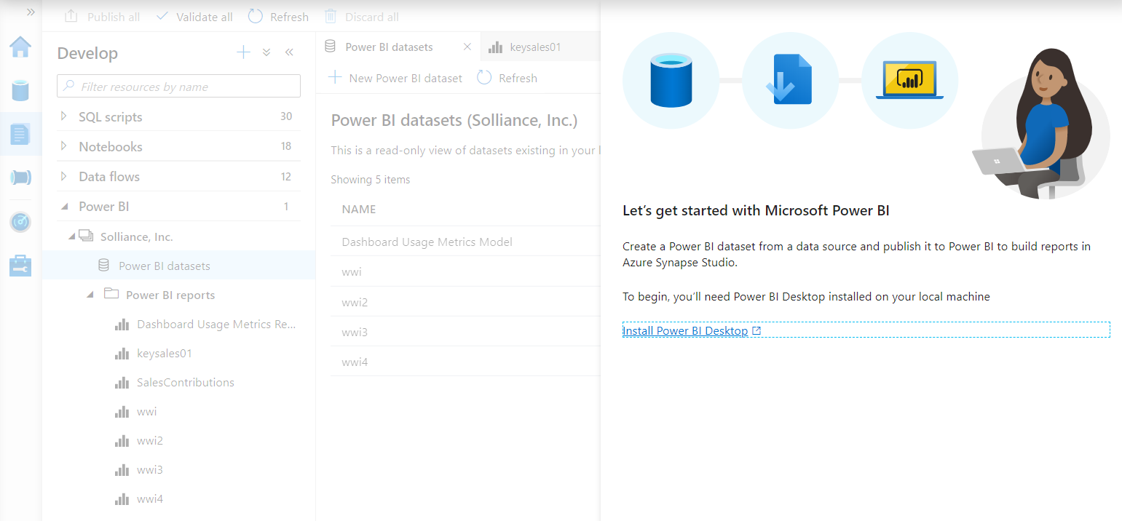
Create datasets with Power BI Desktop
Click New Power BI dataset under Power BI datasets

Slide 13
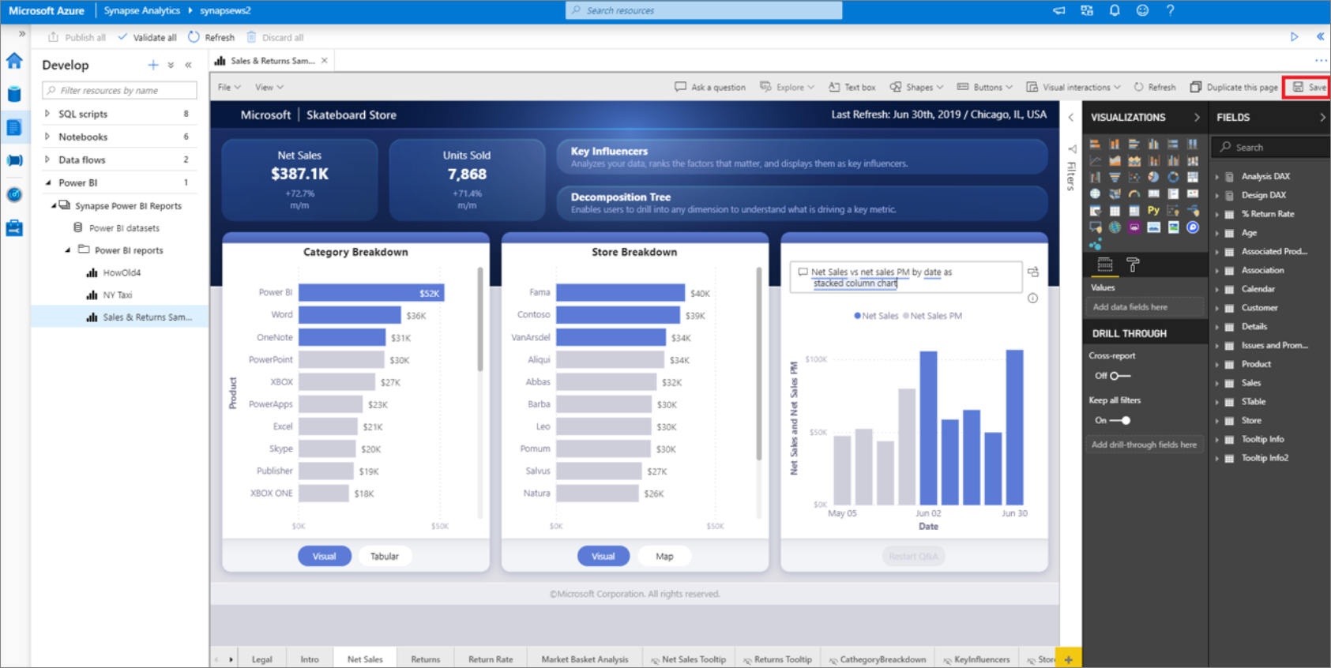
Create PowerBI reports in Synapse
Click + at the top of the Develop tab

Slide 14
Performance Optimization
Notes:
https://www.jamesserra.com/archive/2019/12/azure-synapse-analytics-power-bi/

Slide 15
Options to retrieve data in Power BI
Import:
data imported into memory
DirectQuery:
query data source as you interact with visualizations
Composite model:
combine data from a mix of DirectQuery sources and imported data
Dual Storage Mode:
depending on the context of the query tables can act as either cached (imported) or not cached
Aggregations:
an aggregated table (in-memory) from an underlying detail table (DirectQuery)

Slide 16
Result-set caching
Automatically caches query results in the user database for repetitive use. This allows subsequent query executions to get results directly from the persisted cache so recomputation is not needed. Result set caching improves query performance (down to milliseconds) and reduces compute resource usage. In addition, queries using cached results set do not use any concurrency slots in Azure Synapse Analytics and thus do not count against existing concurrency limits

Slide 17
Materialized views
A view that pre-computes, stores, and maintains its data in SQL DW just like a table. There’s no recomputation needed each time when a materialized view is used. Queries that use all or a subset of the data in materialized views can get faster performance. Even better, queries can use a materialized view without making direct reference to it, so there’s no need to change application code

Slide 18
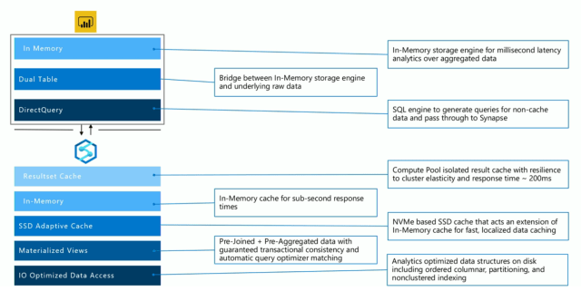
Performance optimization end-to-end

Slide 19
SQL Pool resource allocation
DWU units
Resource classes, workload management
Synapse SQL Pool vs. Azure Analysis Services
Notes:
TB detailed

Slide 20
Thank You slide
Thank you

